Slide 1
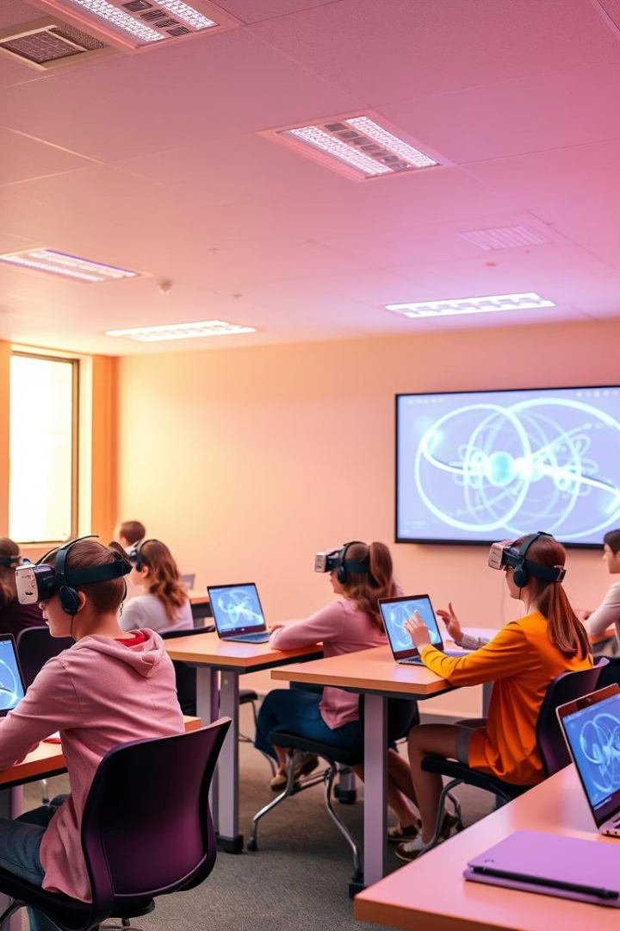
Interactive Learning for Complex Topics — QUANTUM LEARNING
By Syed Yasser (2022530) and Md. Kaif (2022289)
Course: Design Research

Slide 2

Introduction
Quantum subjects are often seen as rocket science only for experts.
Students struggle to grasp and enjoy the core concepts without interactive tools.
Our study combines literature review and a survey to explore better learning methods.

Slide 3



Rationale
Learning Difficulties
Traditional Limitations
Quantum physics and computing are hard to grasp for many students.
Lack of hands-on experiments limits understanding and engagement.

Slide 4
Objectives
Analyze Learning Methods
Explore Tools
Data Collection
Compare methodologies from existing literature.
Study video learning, VR, gamification, and animations.
Conduct a Google Forms survey with students and educators.
Impact Study
Recommend Strategies
Assess effects on memory retention.
Suggest improved learning approaches.

Slide 5
Research Methodology
Literature Review
Survey
Data Analysis
Analyzed 12+ academic papers on quantum learning.
Google Forms survey with students and educators.
Combined qualitative and quantitative methods.

Slide 6





Literature Review Highlights
VR Wave-Particle Duality
QuILT Tutorial
Immersive visualization of quantum phenomena.
2
Guided learning approach for quantum concepts.
1
Gamified Tools
Quantum Odyssey, Hello Quantum, Qubit Touchdown enhance engagement.
3
5
AI Learning
QuantumAiEd platform adapts to learner needs.
Hands-on Kits
4
Portable NMR devices for practical experience.

Slide 7




VR Enhances Quantum Mechanics Learning
Immersive Experience
Improved Understanding
Better Retention
Increased Motivation
Virtual reality modules simulate quantum experiments practically.
Students grasp wave-particle duality with less confusion.
VR outperforms traditional methods in clarity and memory retention.
Engaging VR boosts student enthusiasm and interest.
Study by Tarng & Pei (2023) in Applied Sciences shows VR's strong benefits in quantum physics education. See more at Applied Sciences journal.

Slide 8



QuantumAiEd: AI-Powered Quantum Computing Education
QuantumAiEd bridges the gap in quantum computing education for high school and undergraduates.
This AI platform offers personalized learning with interactive content, quizzes, and instant feedback.
By adapting to individual needs, it simplifies complex quantum concepts and boosts engagement.
A pilot study with 20 students showed improved understanding and positive user experience.
Accessibility
Inclusivity
Impact
Enables personalized QC learning regardless of prior physics or math background.
Supports diverse learners aiming to build a skilled future quantum workforce.
Initial trials reveal improved retention and engagement with quantum topics.
Study by Harnandez & Patel (2025) in Enhancing Early Quantum Computing Education with QuantumAiEd: Bridging the Educational Gap. See more at
Quantum Computing Education with QuantumAiEd.

Slide 9
Survey Structure Overview
Background Information
Learning Experience & Preferences
Participant role: Student, Educator, Researcher, Other
Preferred formats: Videos, simulations, VR/AR, gamification
Quantum familiarity level: None to Expert
Experience studying or teaching quantum topics: Yes/No
Effective tools for abstract concepts
Engagement and improvement ratings (1-5 scale)
Challenges faced in quantum learning or teaching

Slide 10




Survey Insights
Respondent Profile
Preferred Tools
Mostly students and educators participated.
Simulations, VR, and games rated highest for engagement.
Traditional Methods
Textbooks and lectures rated lowest for engagement.

Slide 11
Challenges and Recommendations
Challenges
Recommendations
Abstract nature of quantum topics
Use visual, gamified, adaptive platforms
Lack of accessible hands-on resources
Design for diverse learning styles
Low interactivity in current materials
Incorporate animations, challenges, hybrid models

Slide 12




Conclusion and Future Scope
Conclusion
Interactive and hybrid learning improves quantum education.
Limitations
Small sample size and lack of long-term retention data.
Future Scope
Expand studies, AI-driven platforms, curriculum integration.

Slide 13
References
arXiv:2501.10449 - Quantum Learning Methods
PhysRev Phys Educ Res - Quantum Education Study
ACM DL - Gamification in Quantum Learning
MDPI Applied Sciences - VR and Quantum Physics
arXiv:2202.07756 - Adaptive AI in Quantum Education
arXiv:2406.11995 - Future of Quantum Learning Tools

